Slide 1
AŞKALE GROUP
GENERAL PRESENTATION
12-09-2018

Slide 2
ASKALE GROUP PRESENTATION TOPICS
PRESENTATION TOPICS:
1-) ASKALE GROUP CLINKER, CEMENT PRODUCTION CAPACITY AND TURNOVER :
2-) CEMENT PLANT OF ASKALE GROUPS :
3-) READY MIX AND AGGREGATE PLANTS OF ASKALE GROUP:
4-) ASKALE GROUP HOPA CEMENT TERMINAL:
5-) ASKALE GROUP’S SUB-FACILITIES:

Slide 3
1-AŞKALE GROUP CLINKER, CEMENT PRODUCTION CAPACITY AND TURNOVER
TOTAL CLINKER CAPACITY OF ASKALE GROUP:
7.011.146 TON/YEAR
TOTAL CEMENT CAPACITY OF ASKALE GROUP:
14.079.422 TON/YEAR
TURNOVER OF ASKALE GROUP:
1.500.000.000 TL

Slide 4
2- CEMENT PLANTS OF AŞKALE GROUP
AŞKALE GROUP HAVE 5 INTEGRATED PLANTS AND 2 GRINDING STATIONS :
AŞKALE INTEGRATED CEMENT PLANT :
GÜMÜŞHANE INTEGRATED CEMENT PLANT :
VAN INTEGRATED CEMENT PLANT:
SANÇİM INTEGRATED CEMENT PLANT :
KAVÇİM INTEGRATED CEMENT PLANT :
ERZİNCAN GRINDING STATION:
TRABZON GRINDING STATION :

Slide 5
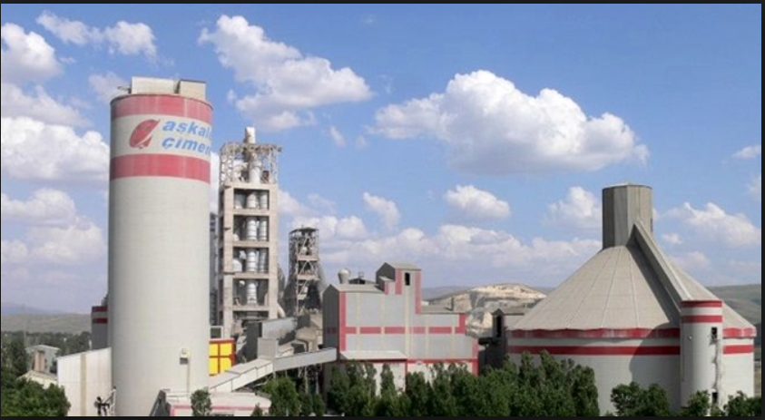
AŞKALE CEMENT PLANT’S CLINKER AND CEMENT CAPACITY
TOTAL CLINKER CAPACITY OF ASKALE CEMENT PLANT :
1.609.157 TON/YEAR
TOTAL CEMENT CAPACITY OF ASKALE CEMENT PLANT :
1.692.432 TON/YEAR

Slide 6
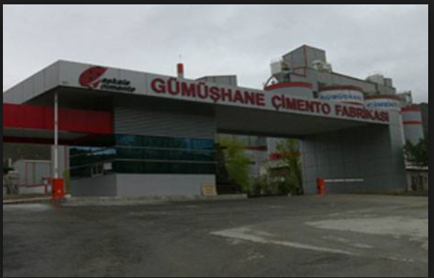
GUMUSHANE CEMENT PLANT’S CLINKER AND CEMENT CAPACITY
TOTAL CLINKER CAPACITY OF GUMUSHANE CEMENT PLANT:
1.501.774 TON/YEAR
TOTAL CEMENT CAPACITY OF GUMUSHANE CEMENT PLANT:
2.014.800 TON/YEAR

Slide 7
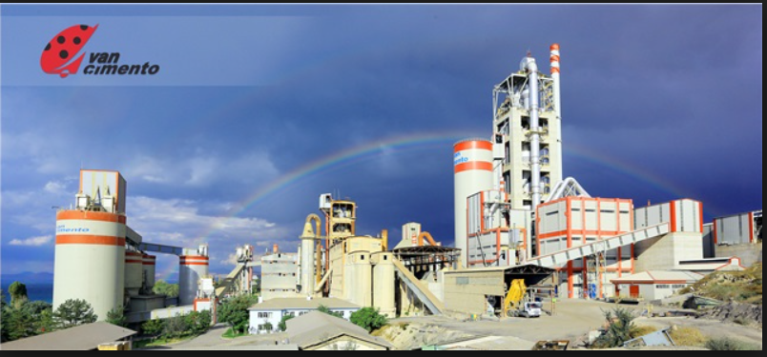
VAN CEMENT PLANT’S CLINKER AND CEMENT CAPACITY
TOTAL CLINKER CAPACITY OF VAN CEMENT PLANT:
1.147.122 TON/YEAR
TOTAL CEMENT CAPACITY OF VAN CEMENT PLANT :
2.151.806 TON/YEAR

Slide 8
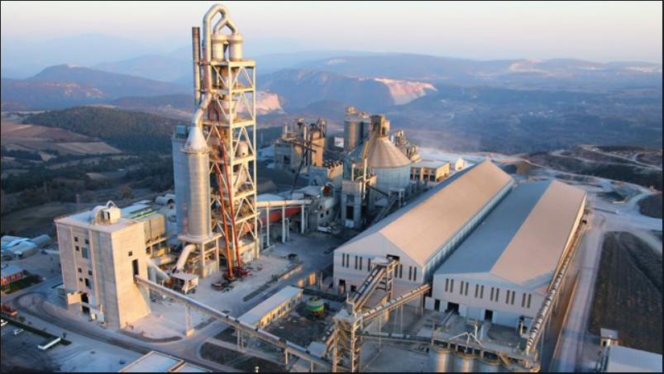
SANCIM CEMENT PLANT’S CLINKER AND CEMENT CAPACITY
TOTAL CLINKER CAPACITY OF SANCIM CEMENT PLANT :
1.159.868 TON/YEAR
TOTAL CEMENT CAPACITY OF SANCIM CEMENT PLANT :
2.498.352 TON/YEAR

Slide 9
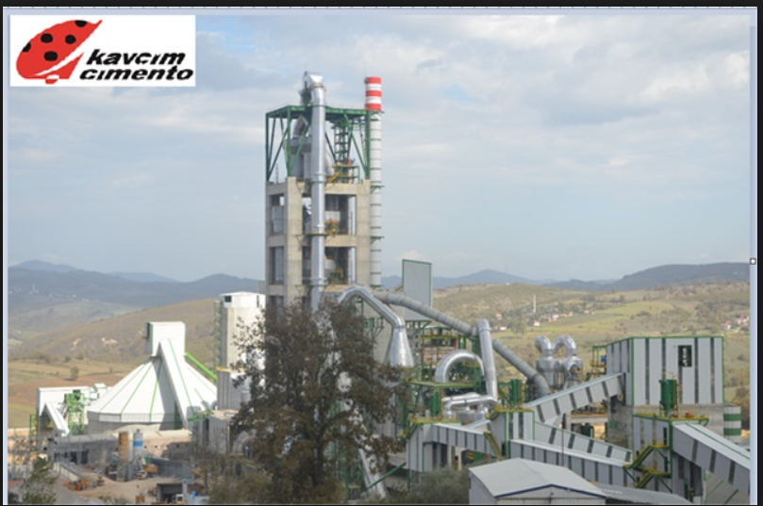
KAVCIM CEMENT PLANT’S CLINKER AND CEMENT CAPACITY
TOTAL CLINKER CAPACITY OF KAVCIM CEMENT PLANT :
1.593.225 TON/YEAR
TOTAL CEMENT CAPACITY OF KAVCIM CEMENT PLANT :
3.223.680 TON/YEAR

Slide 10
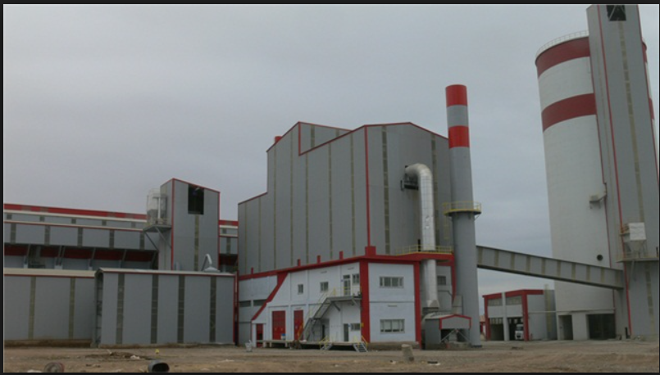
ERZINCAN GRINDING PLANT’S CLINKER AND CEMENT CAPACITY
TOTAL CEMENT CAPACITY OF ERZINCAN CEMENT PLANT :
805.920 TON/YEAR

Slide 11
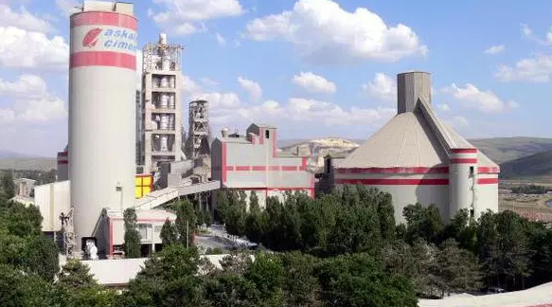
TRABZON GRINDING PLANT’S CLINKER AND CEMENT CAPACITY
TOTAL CEMENT CAPACITY OF TRABZON CEMENT PLANT :
1.692.432 TON/YEAR

Slide 12
3- READY MIX AND AGGREGATE PLANTS OF AŞKALE GROUP
AŞKALE GROUP HAVE 12 READY MIX PLANTS AND 1 AGGREGATE PLANT :
ILICA READY MIX PLANT:
GECIT READY MIX PLANT:
AĞRI READY MIX PLANT:
OVAAKCA READY MIX PLANT:
ASKALE READY MIX PLANT:
YENISEHIR READY MIX PLANT:
BESIKDUZU READY MIX PLANT :
BILECIK READY MIX PLANT:
TİREBOLU READY MIX PLANT :
ISTANBUL(SAW) READY MIX PLANT:
TRABZON READY MIX PLANT :
RİZE READY MIX PLANT :
TERCAN AGGREGATE PLANT :

Slide 13
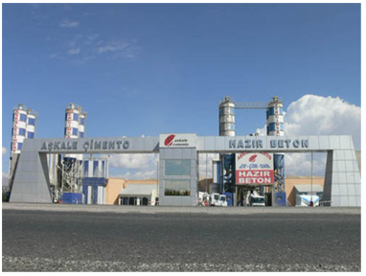
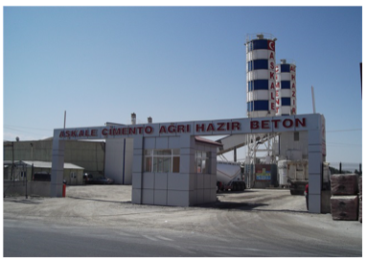
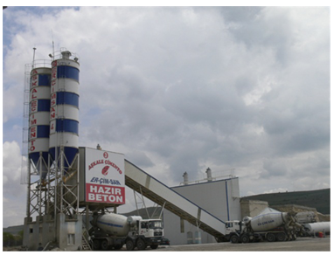
ASKALE GROUP READY-MIX & AGGREGATE PLANTS
ILICA READY-MIX CONCRETE PLANT
AGRI READY-MIX CONCRETE PLANT
ASKALE READY-MIX CONCRETE PLANT
Capacity : 320 m3/h
Capacity : 100 m3/h
Capacity : 120 m3/h

Slide 14
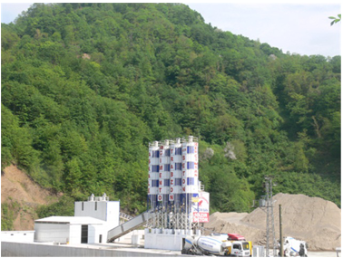
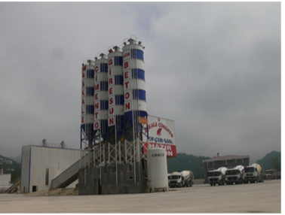
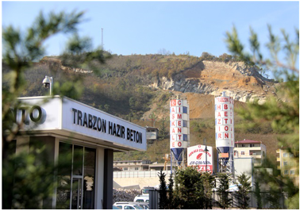
ASKALE GROUP READY-MIX & AGGREGATE PLANTS
BESIKDUZU READY-MIX CONCRETE PLANT
TIREBOLU READY-MIX CONCRETE
PLANT
TRABZON READY-MIX CONCRETE PLANT
Capacity : 160 m3/h
Capacity : 160 m3/h
Capacity : 90 m3/h

Slide 15
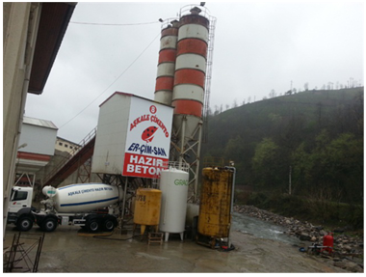
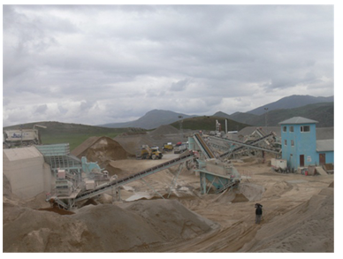
ASKALE GROUP READY-MIX & AGGREGATE PLANTS
RIZE READY-MIX CONCRETE PLANT
TERCAN AGGREGATE PLANT
Capacity : 120 m3/h
Capacity : 250 ton/h

Slide 16
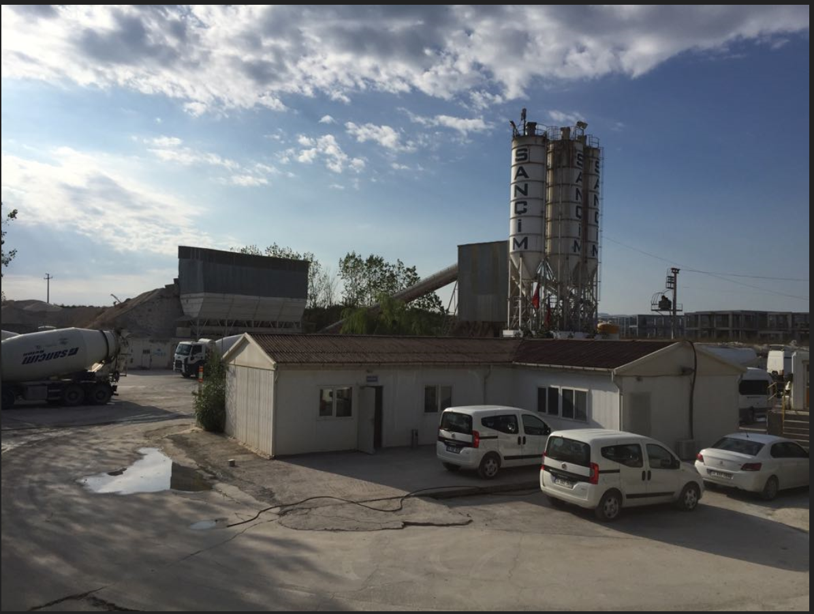
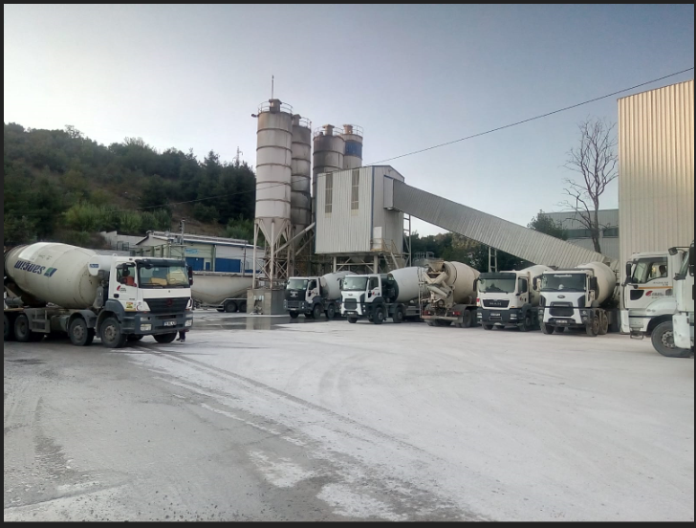
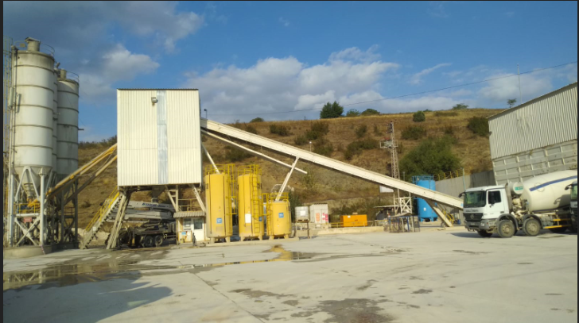
ASKALE GROUP READY-MIX & AGGREGATE PLANTS
GECIT READY-MIX CONCRETE
PLANT
OVAAKCA READY-MIX CONCRETE
PLANT
YENISEHIR READY-MIX CONCRETE
PLANT
Capacity : 120 m3/h
Capacity : 120 m3/h
Capacity : 100 m3/h

Slide 17
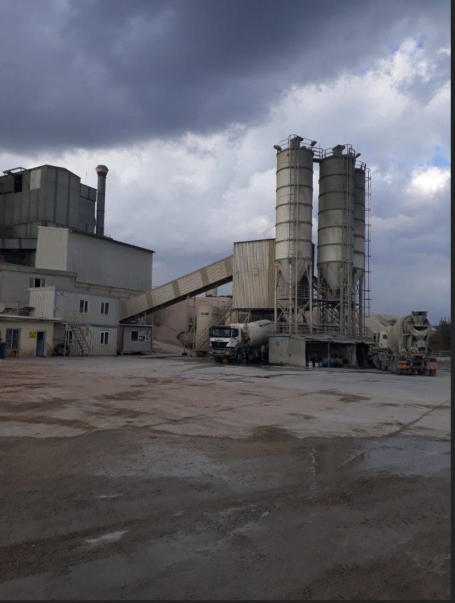
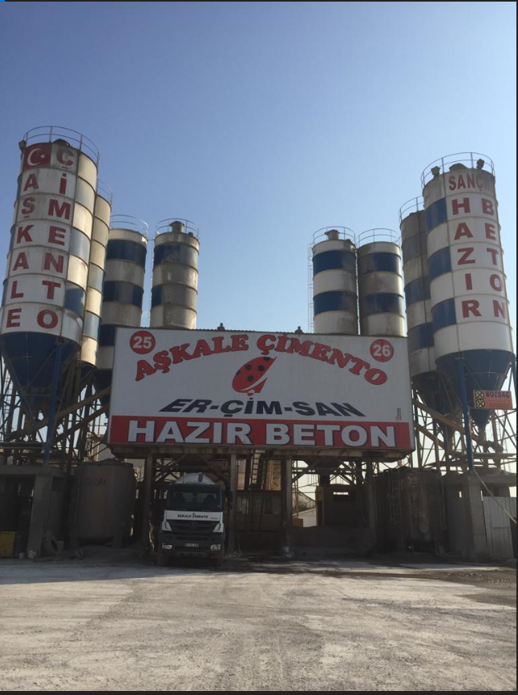
ASKALE GROUP READY-MIX & AGGREGATE PLANTS
BILECIK READY-MIX CONCRETE PLANT
ISTANBUL(SAW) READY-MIX CONCRETE PLANT
Capacity : 90 m3/h
Capacity :160 ton/h

Slide 18
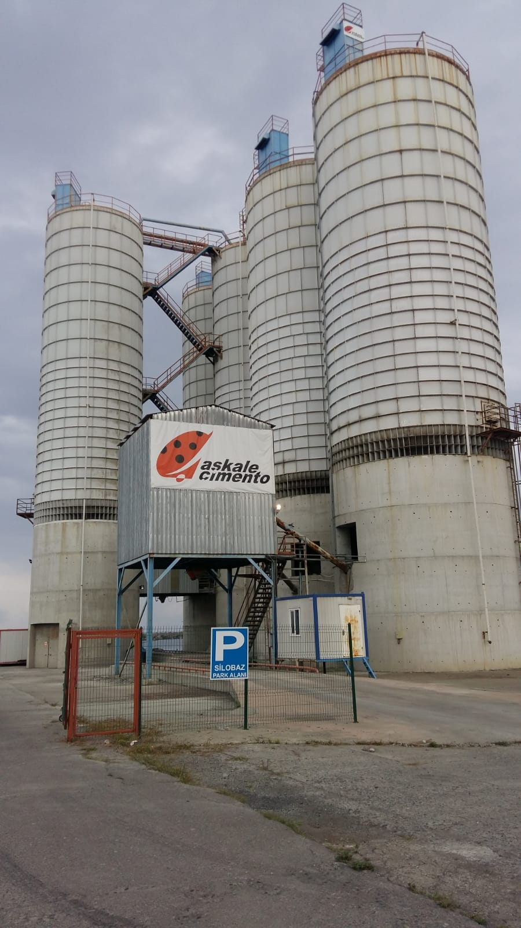
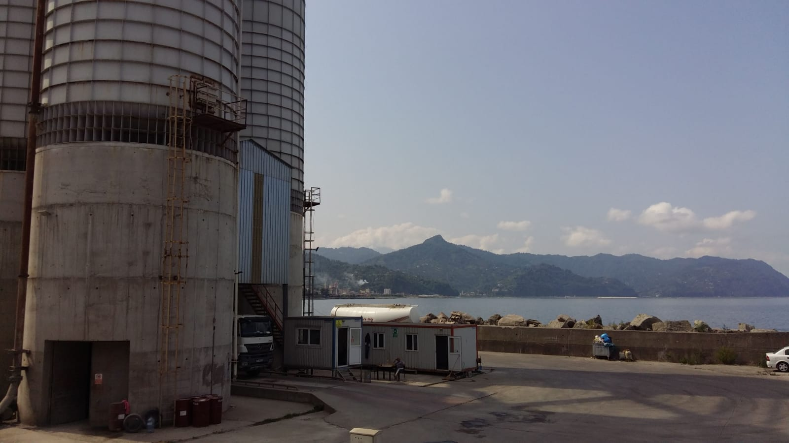
4-ASKALE GROUP HOPA CEMENT TERMINAL
CEMENT SILOS (3 PIESCES)
FLY ASH SILOS (2 PIESCES)
EACH ONE 1.450 TON CAPACITY
EACH ONE 1.750 TON CAPACITY
FROM BEGINNING OF THE THIS YEAR TILL NOW TOTALLY 65.250 TON CEMENT AND 4.522 TON FLY ASS SOLD

Slide 19
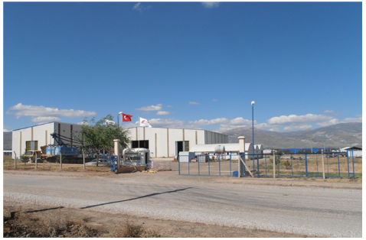
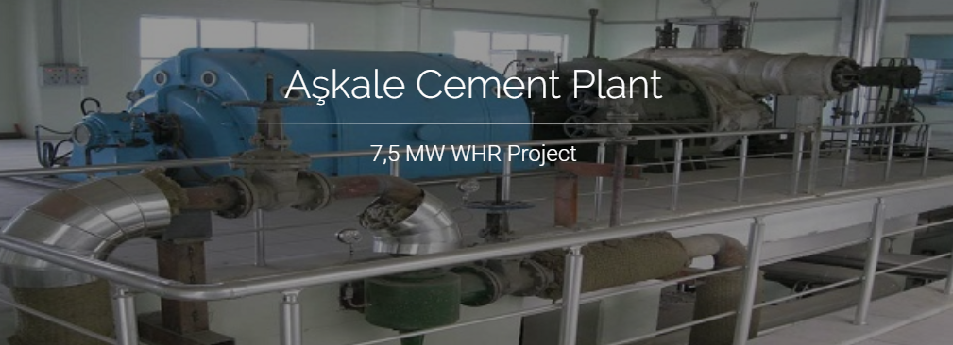
5- ASKALE GROUP’S SUB-FACILITIES
RENEWABLE ENERGY
IRON AND STEEL PLANT
Installation Power 7,5 megawatts per hour Annual Average Production 60.000 megawatts
The Annual Saving 3.2 million $
Located at Aşkale Cement Plant
Erzincan İmalat Tesisi has 3200 square meters covered area
and is a big factory with 800 square meters dye house,
8200 square meters pre-production workshop
and 1600 square meter fabricating yard.
It can work at capacity of 250 tons as steel construction manufacturing,
200 tons as mechanical manufacturing, 150 tons as piping, sensitive or
industrial manufacturing, with working periods of 8 hours a day,per month.

